Slide 1
Memory Match Game
An Interactive Word Matching Game
Name : I Antony Gnanamuthu
Email Id : iantonygnanamuthu@gmail.com

Slide 2
Memory Match Game- Overview
Project Summary
The Memory Match Game is an engaging word-matching game designed to enhance memory and vocabulary skills.Players flip cards to find matching word pairs, revealing their meanings upon a successful match.Integrated with Firebase Firestore for tracking progress and storing game data
Key Features
✔️ Random word generation via WordService
✔️ Interactive gameplay with tap-based card revealing
✔️ Power-ups like Reveal Pair and Freeze Time
✔️ Tracks attempts and checks for game completion
✔️ Meaning of matched words displayed
✔️ Saves progress in Firebase Firestore

Slide 3
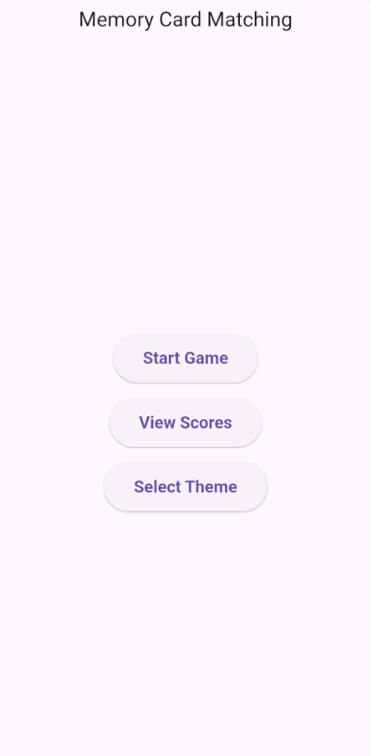
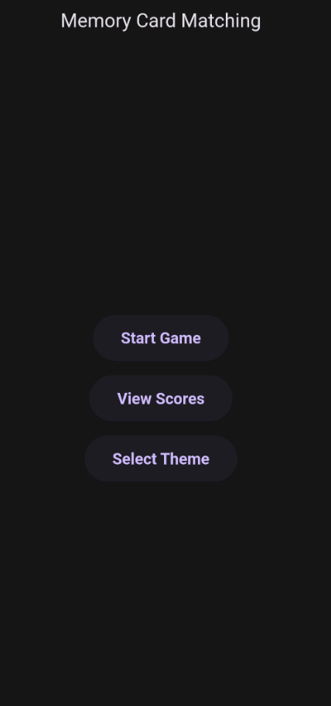
Home page
With white mode
Home page
With dark mode

Slide 4

Home page
This button is for starting the game.
This opens the score board and leader board
This allows to select the theme of the page

Slide 5
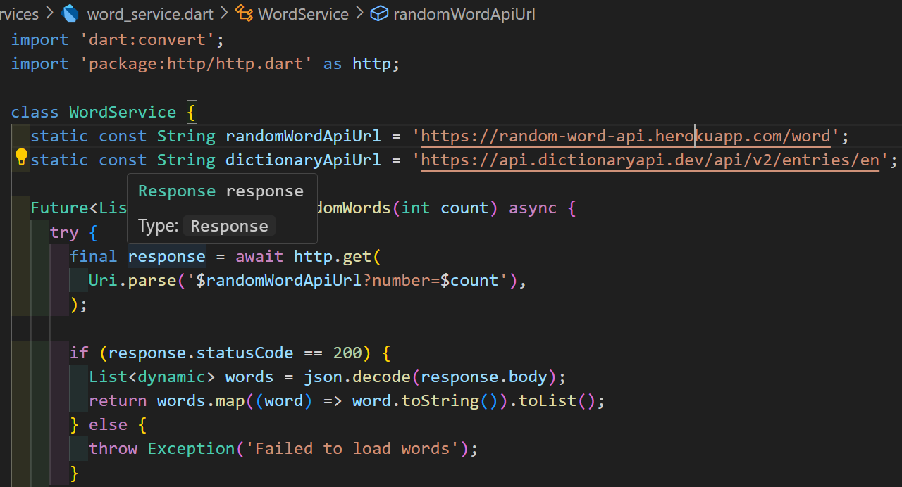
My API service dart file:

Slide 6
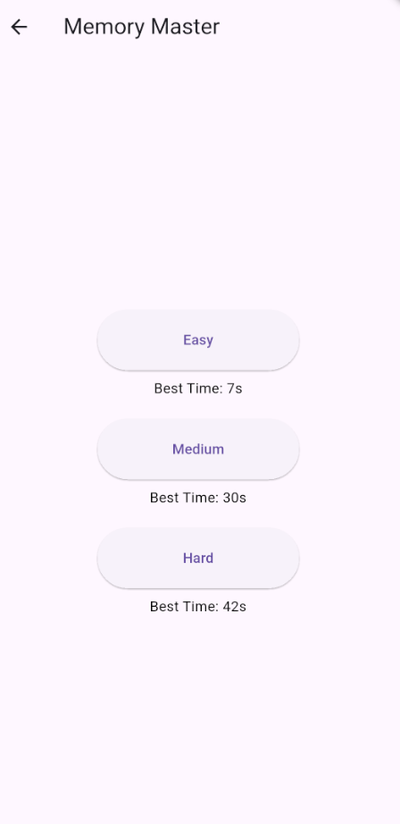
Difficulty page
High Score
Hard mode with 16 cards
Easy mode with 8 cards
Medium mode with 12 cards

Slide 7
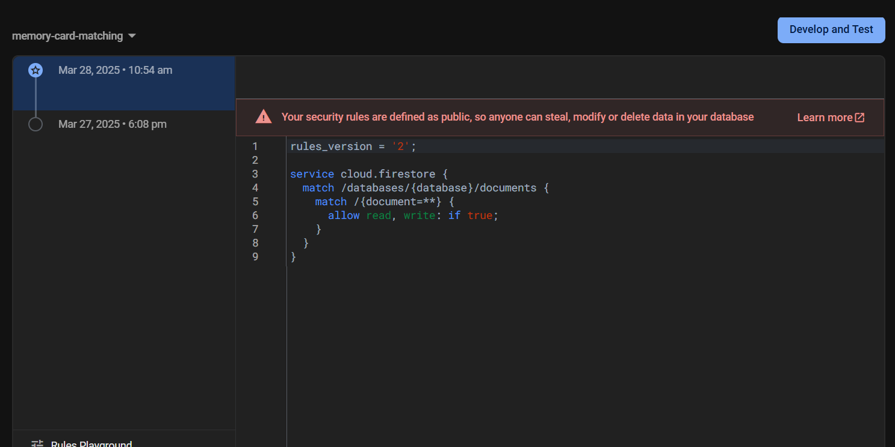
Rules in fire base:
Firebase rules currently allow unrestricted access, will be secured before deployment.

Slide 8
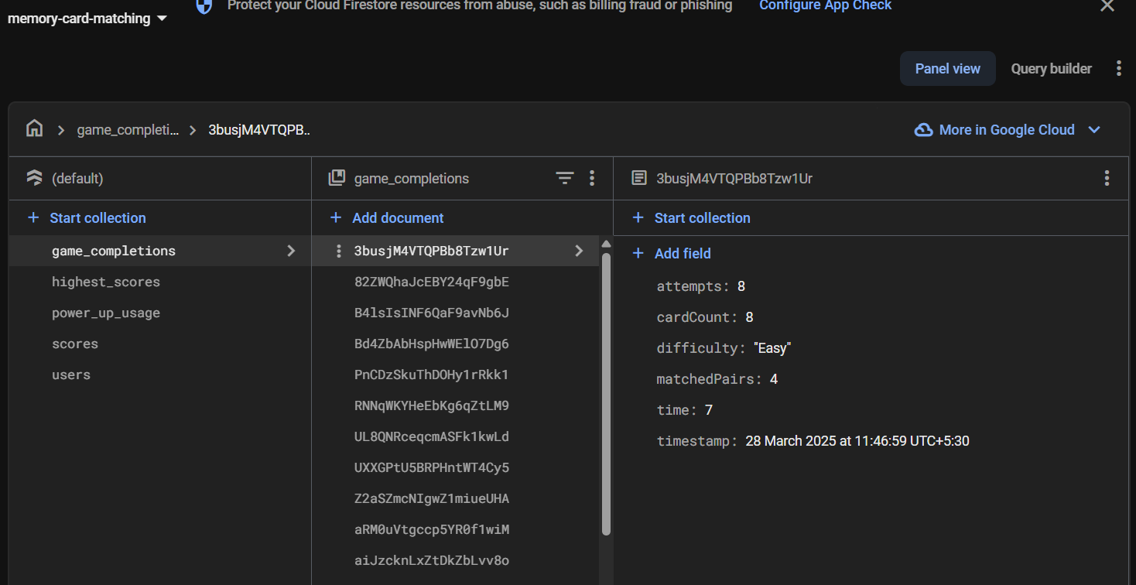

Slide 9
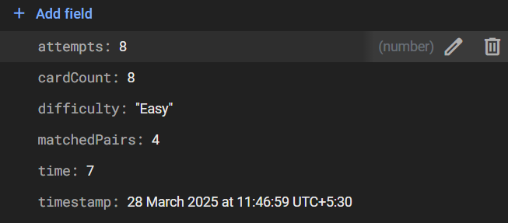
Example data

Slide 10
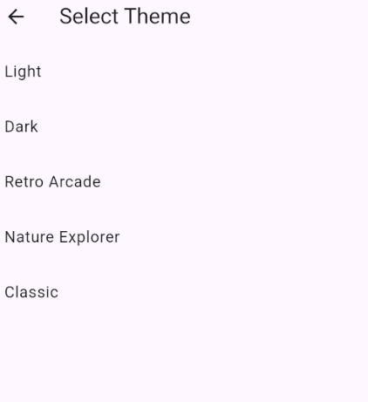
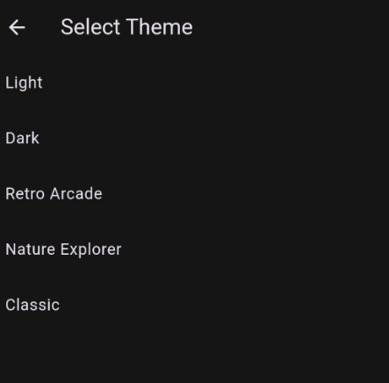
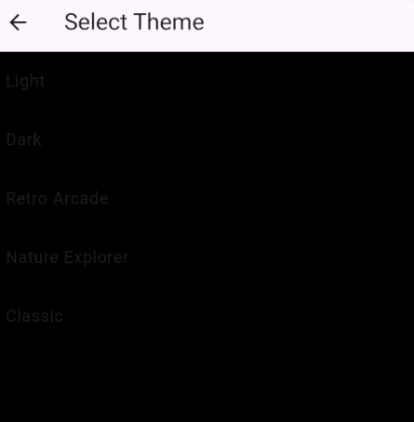
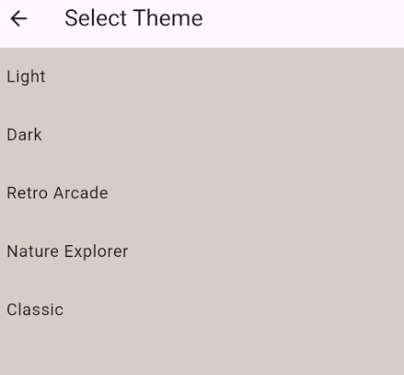
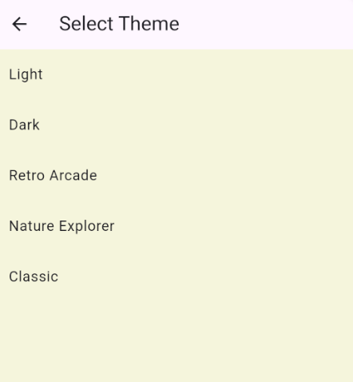
Theme page

Slide 11
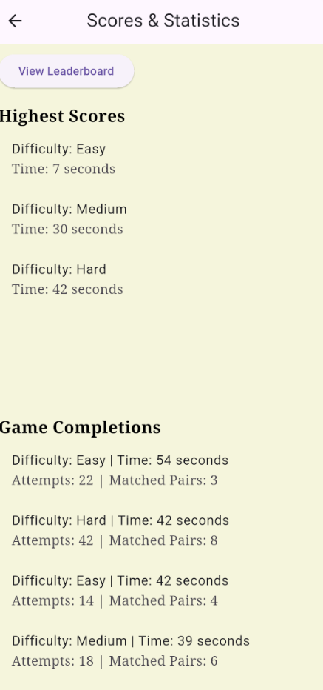
Settings page
button to reach leaderboard
High Scores
Game completions

Slide 12
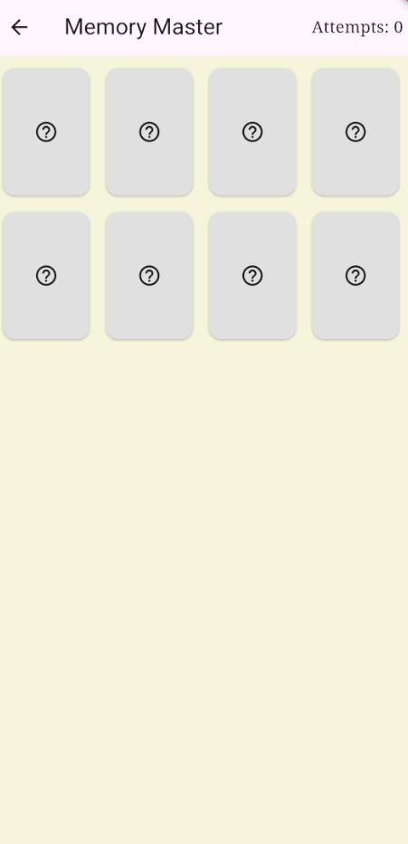
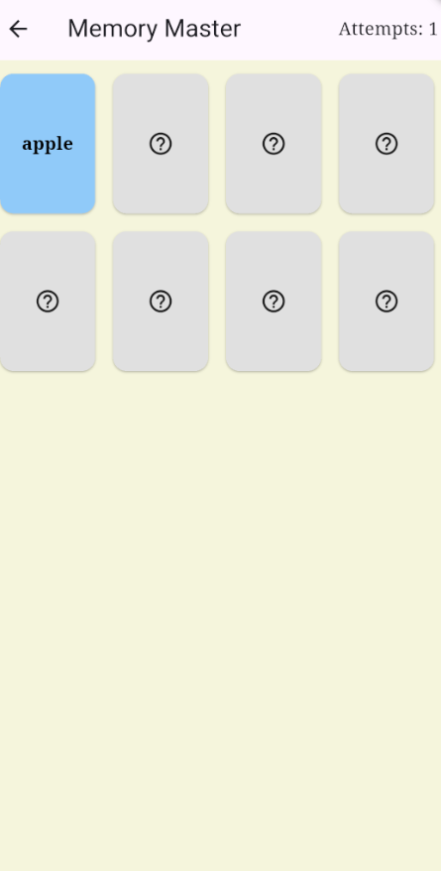
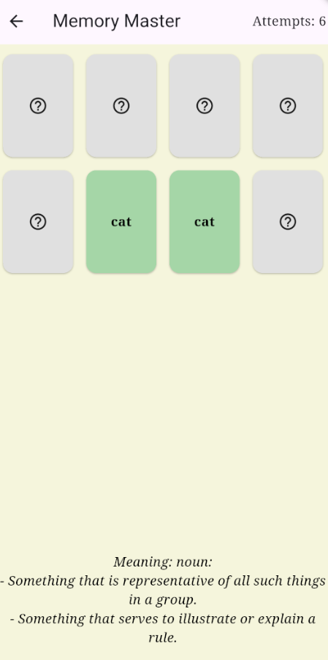
Game page

Slide 13
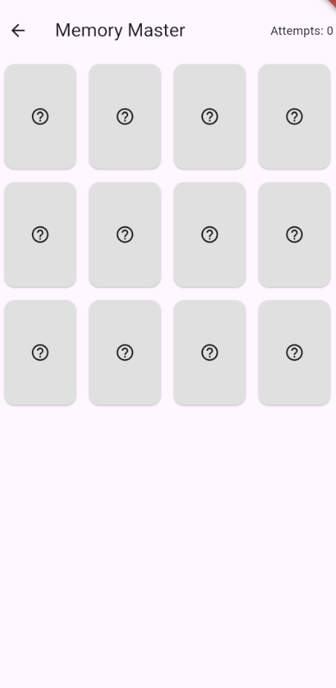
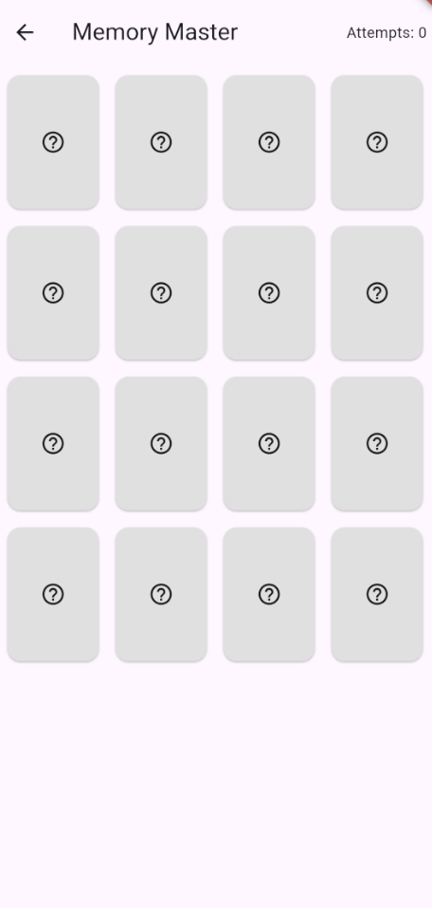
Different difficulty level

Slide 14
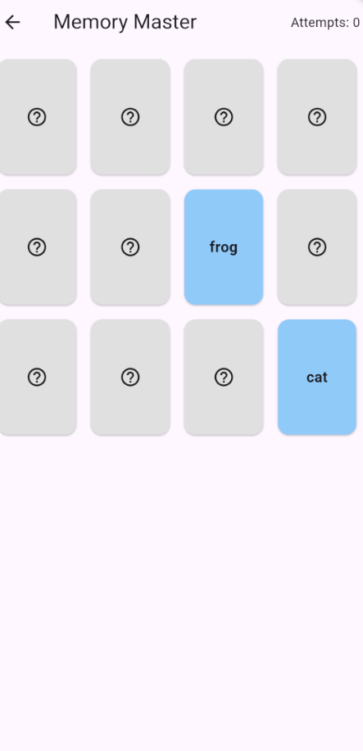
Power ups
When we double tap it opens 2 cards for the user to see.
When the screen is swiped it freezes time.

Slide 15
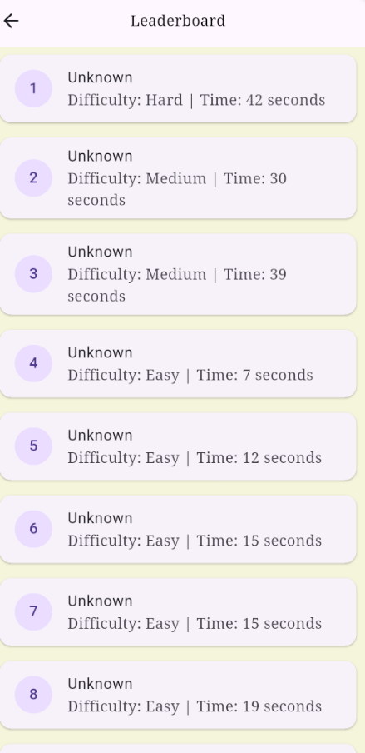
Leader Board

Slide 16
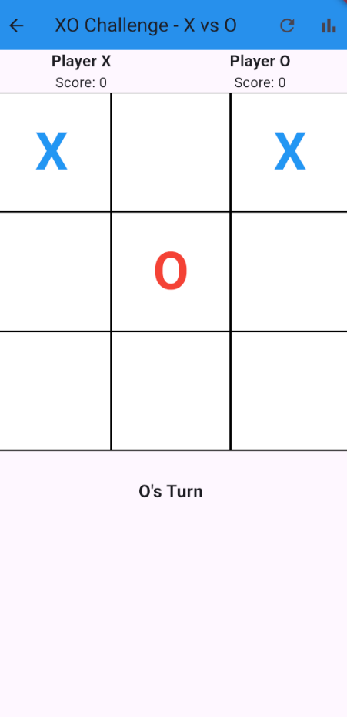
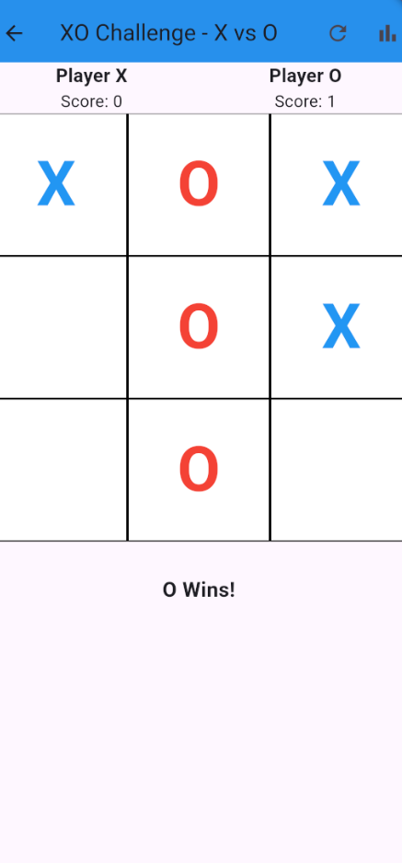
Additional game

Slide 17
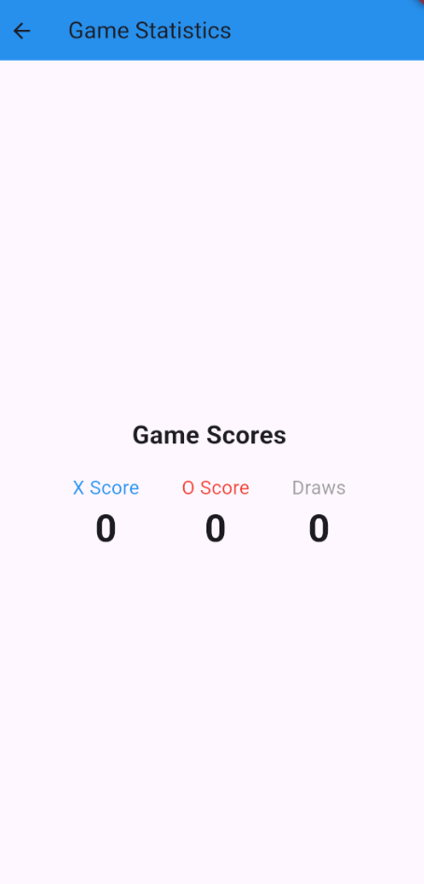
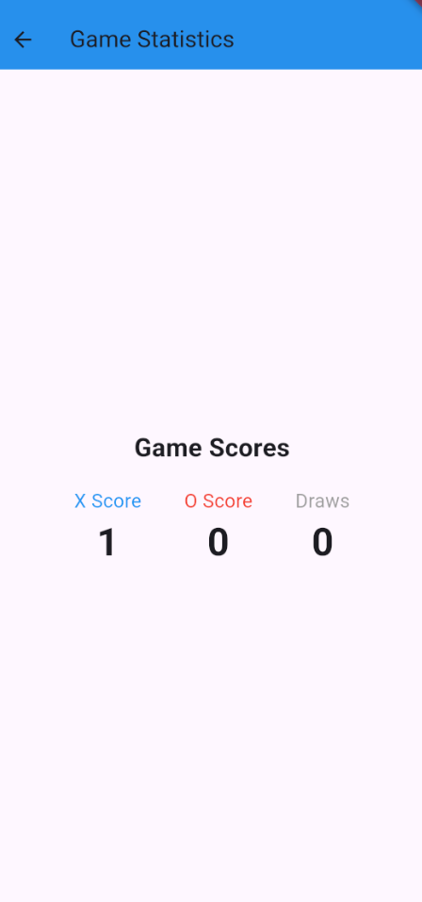
Game statistics

Slide 18
Thank you

